Slide 1
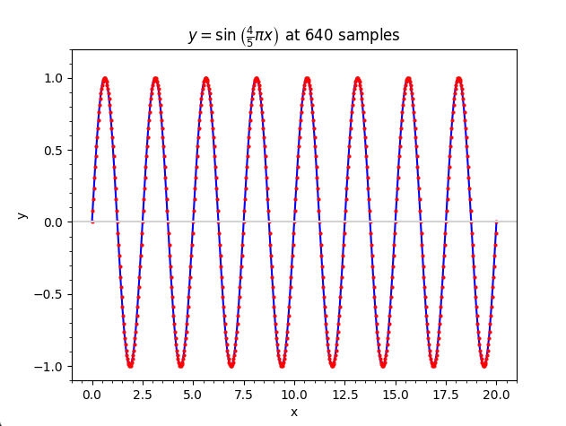
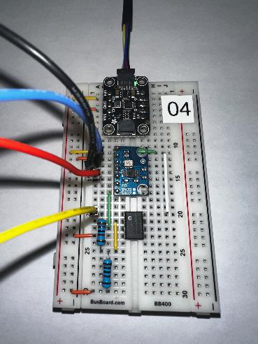
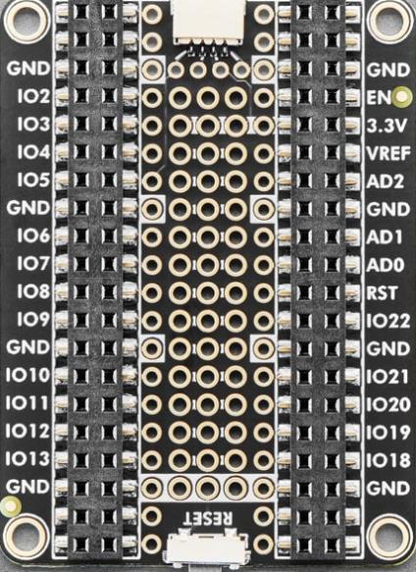
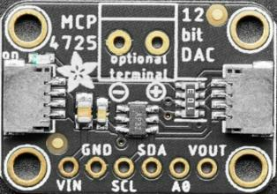
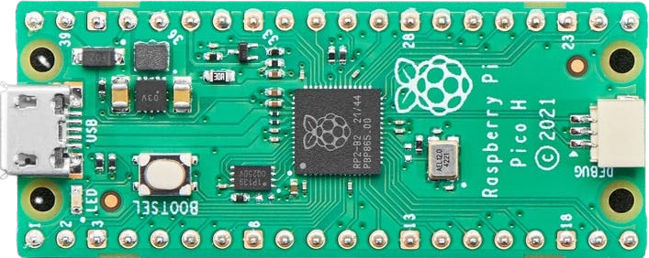
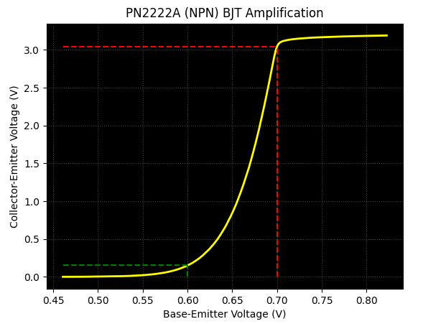

Control System Electronics 101
Using Python and Sensors to Measure Circuits
Board 07
Electromagnets,
Biot-Savart Law
Dave Biersach
dbiersach@bnl.gov

Slide 2
Board 07 – Goals
Apply the Biot-Savart Law as it relates to an electromagnet
Discover the relationship between the current flowing through a solenoid and the strength of the magnetic field at its ends
Use regression analysis (Gauss’s Method of Least Squares) to verify this current to field strength relationship

Slide 3
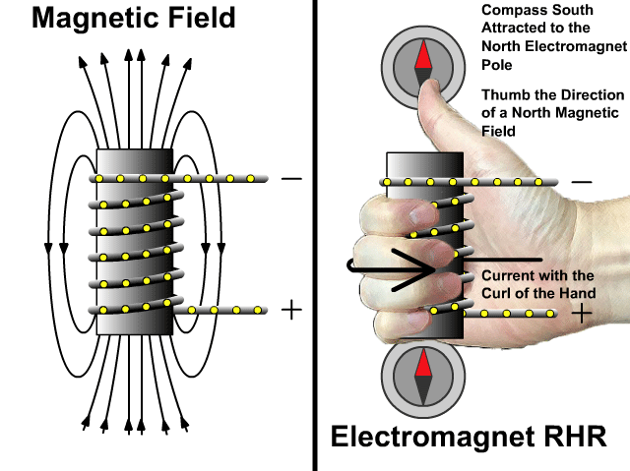
How Electromagnets Work

Slide 4
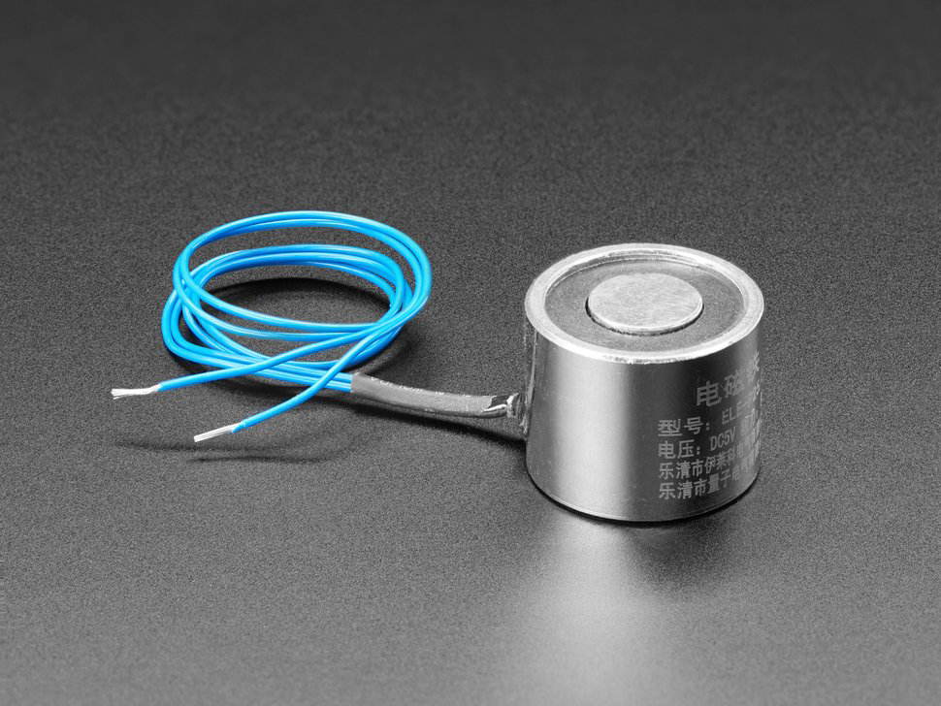
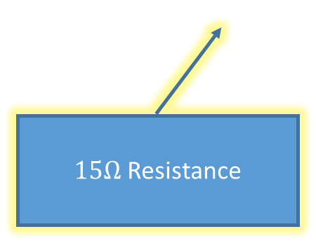
Adafruit 5V Electromagnet
$9.95
https://www.adafruit.com/product/3873
$15Ω$ Resistance

Slide 5
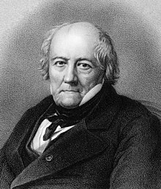
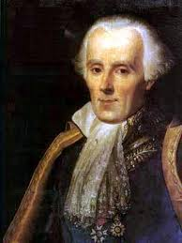
The Biot-Savart Law
Coulomb's Law relates static electric fields to the point charges which are their sources
The Biot-Savart Law relates static magnetic fields to the currents which are their sources
Finding the magnetic field resulting from a current distribution involves the vector product and is inherently a calculus problem when the distance from the steady current to the magnetic field point is continuously changing
Jean-Baptiste Biot
1774-1862
Félix Savart
1791-1841

Slide 6
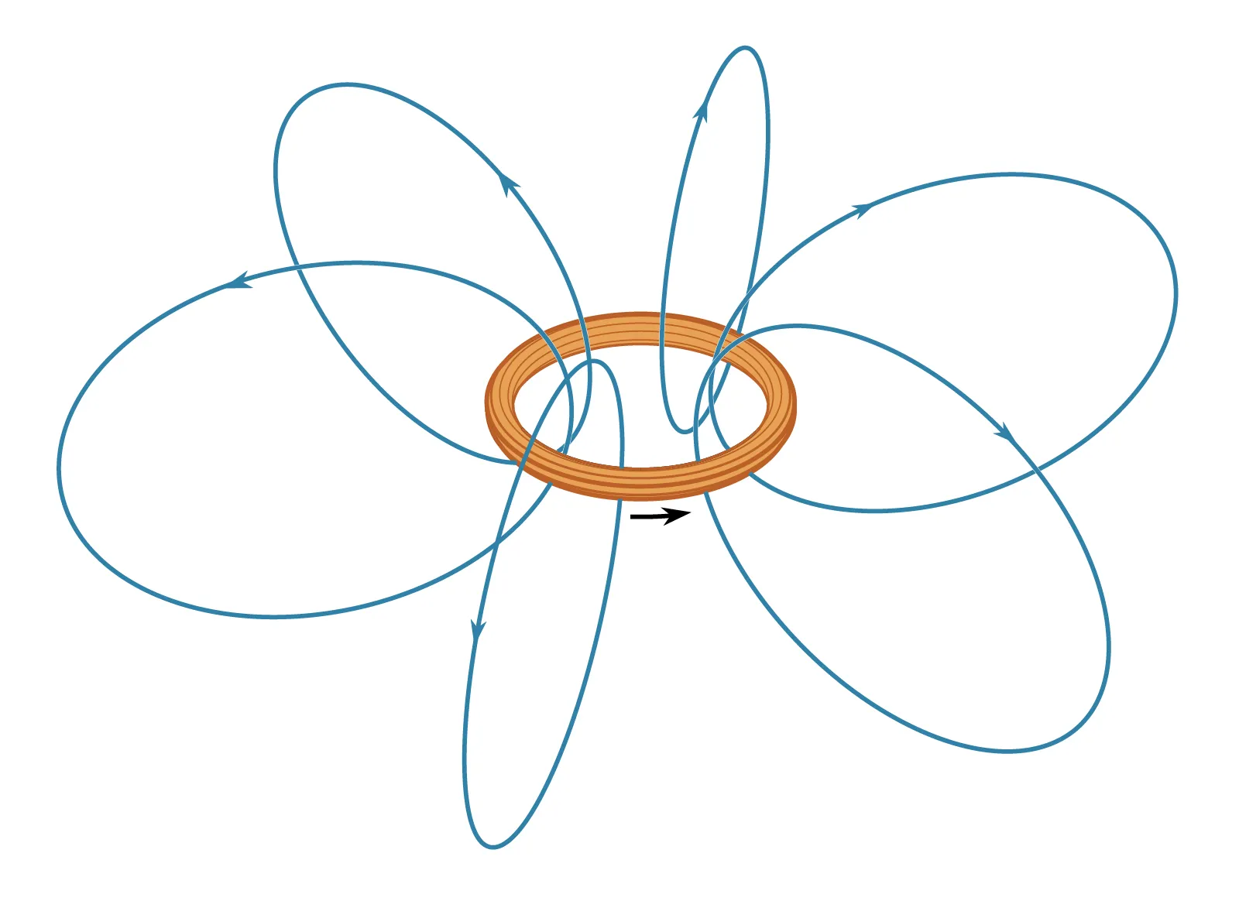
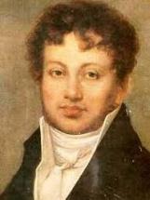
The Biot-Savart Law
Magnetic Field Lines
I
André Ampère
(1775 – 1836)
Moving charges (a current) produce a magnetic field

Slide 7
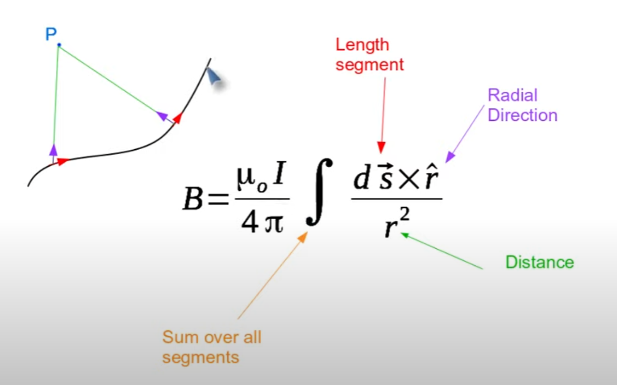
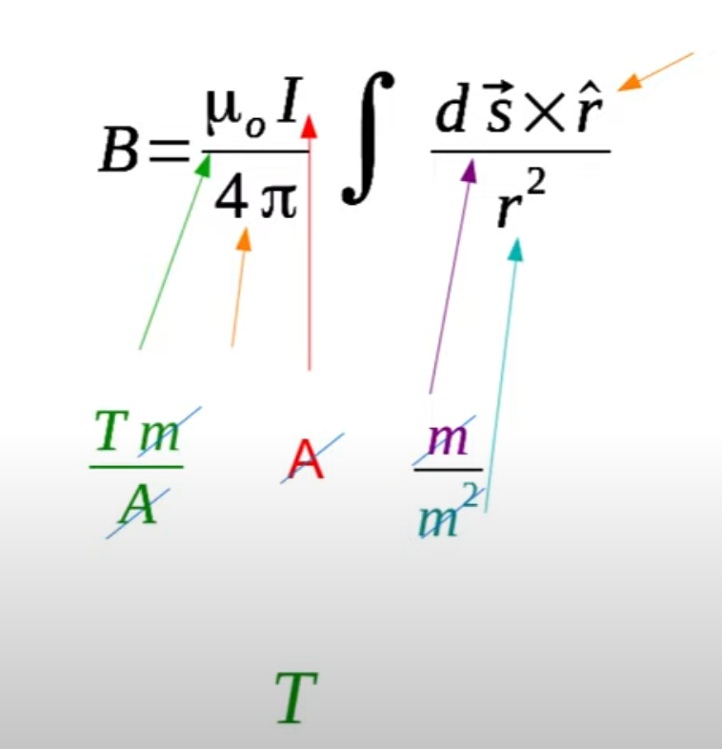
The Biot-Savart Law
Dimensional Analysis
1 Tesla = 10,000 Gauss
Unit of Magnetic Field Strength

Slide 8
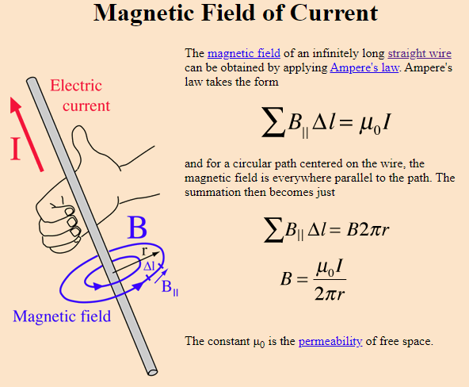
The Biot-Savart Law
For a straight wire

Slide 9
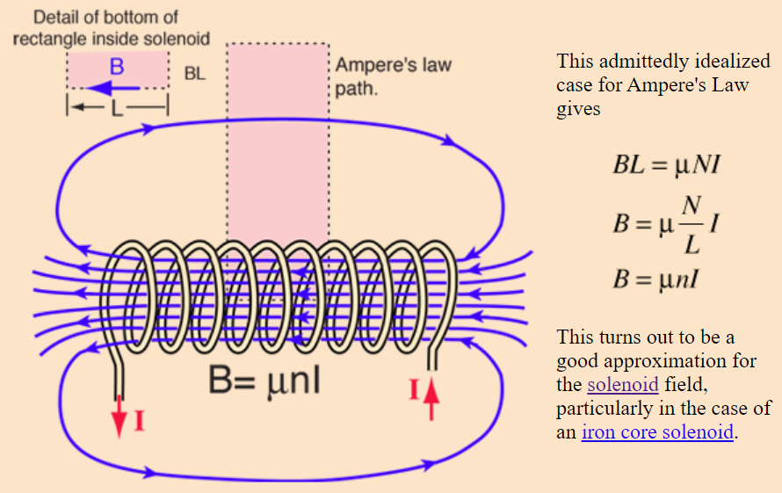
The Biot-Savart Law
$$μ=k×μ_{0}$$
n is # of turns per unit length
(turn "density")
$k$ = relative permeability of the solenoid core
For a coiled electromagnet

Slide 10
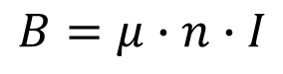
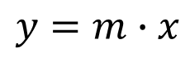
The Biot-Savart Law
$B$ = Strength of electromagnetic field
$$B=μ∙n∙I$$
$μ$ = Relative permeability of electromagnet's core
Assume $u$ and $n$ are constant throughout the length of the electromagnet
$n$ = The turn density of the electromagnet
$$y=m∙x$$
$I$ = Current (in Amps) traveling through the electromagnet
As we increase the current (I) flowing through the electromagnet, the magnetic field strength (B) of the electromagnet should rise at a linear rate

Slide 11
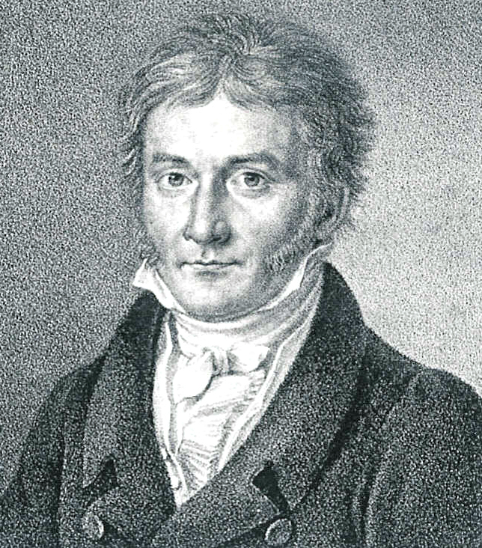
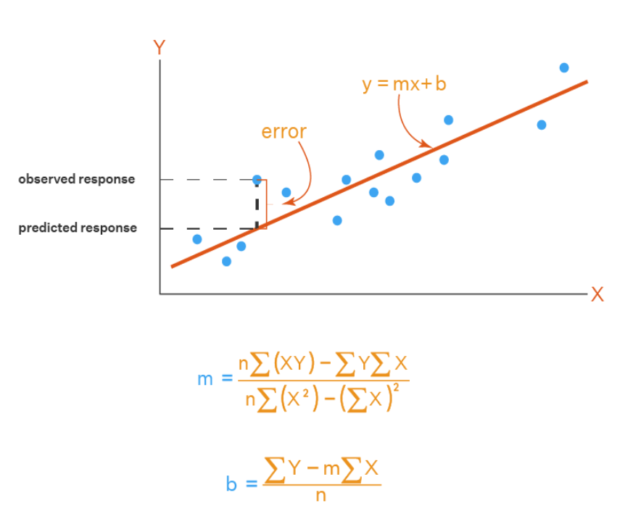
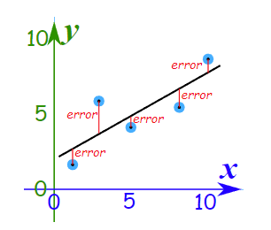
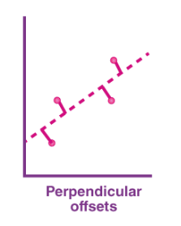
Method of Least Squares
Carl Friedrich Gauss
(1777-1855)

Slide 12
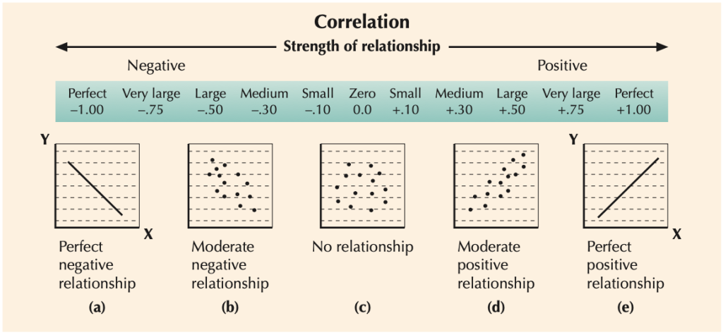
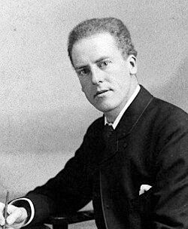
The Pearson Correlation Coefficient
Karl Pearson
(1857-1936)

Slide 13
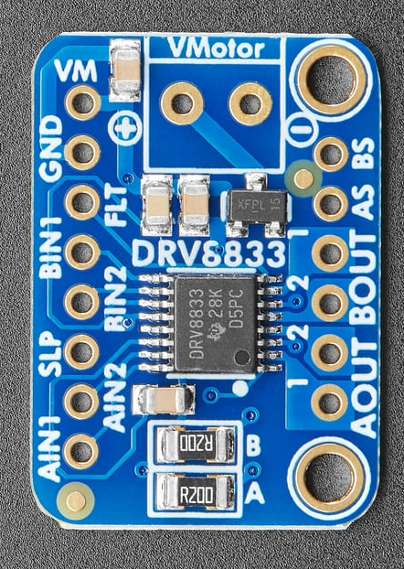
Adafruit DRV8833 Motor Driver
$5.95
https://www.adafruit.com/product/3297

Slide 14
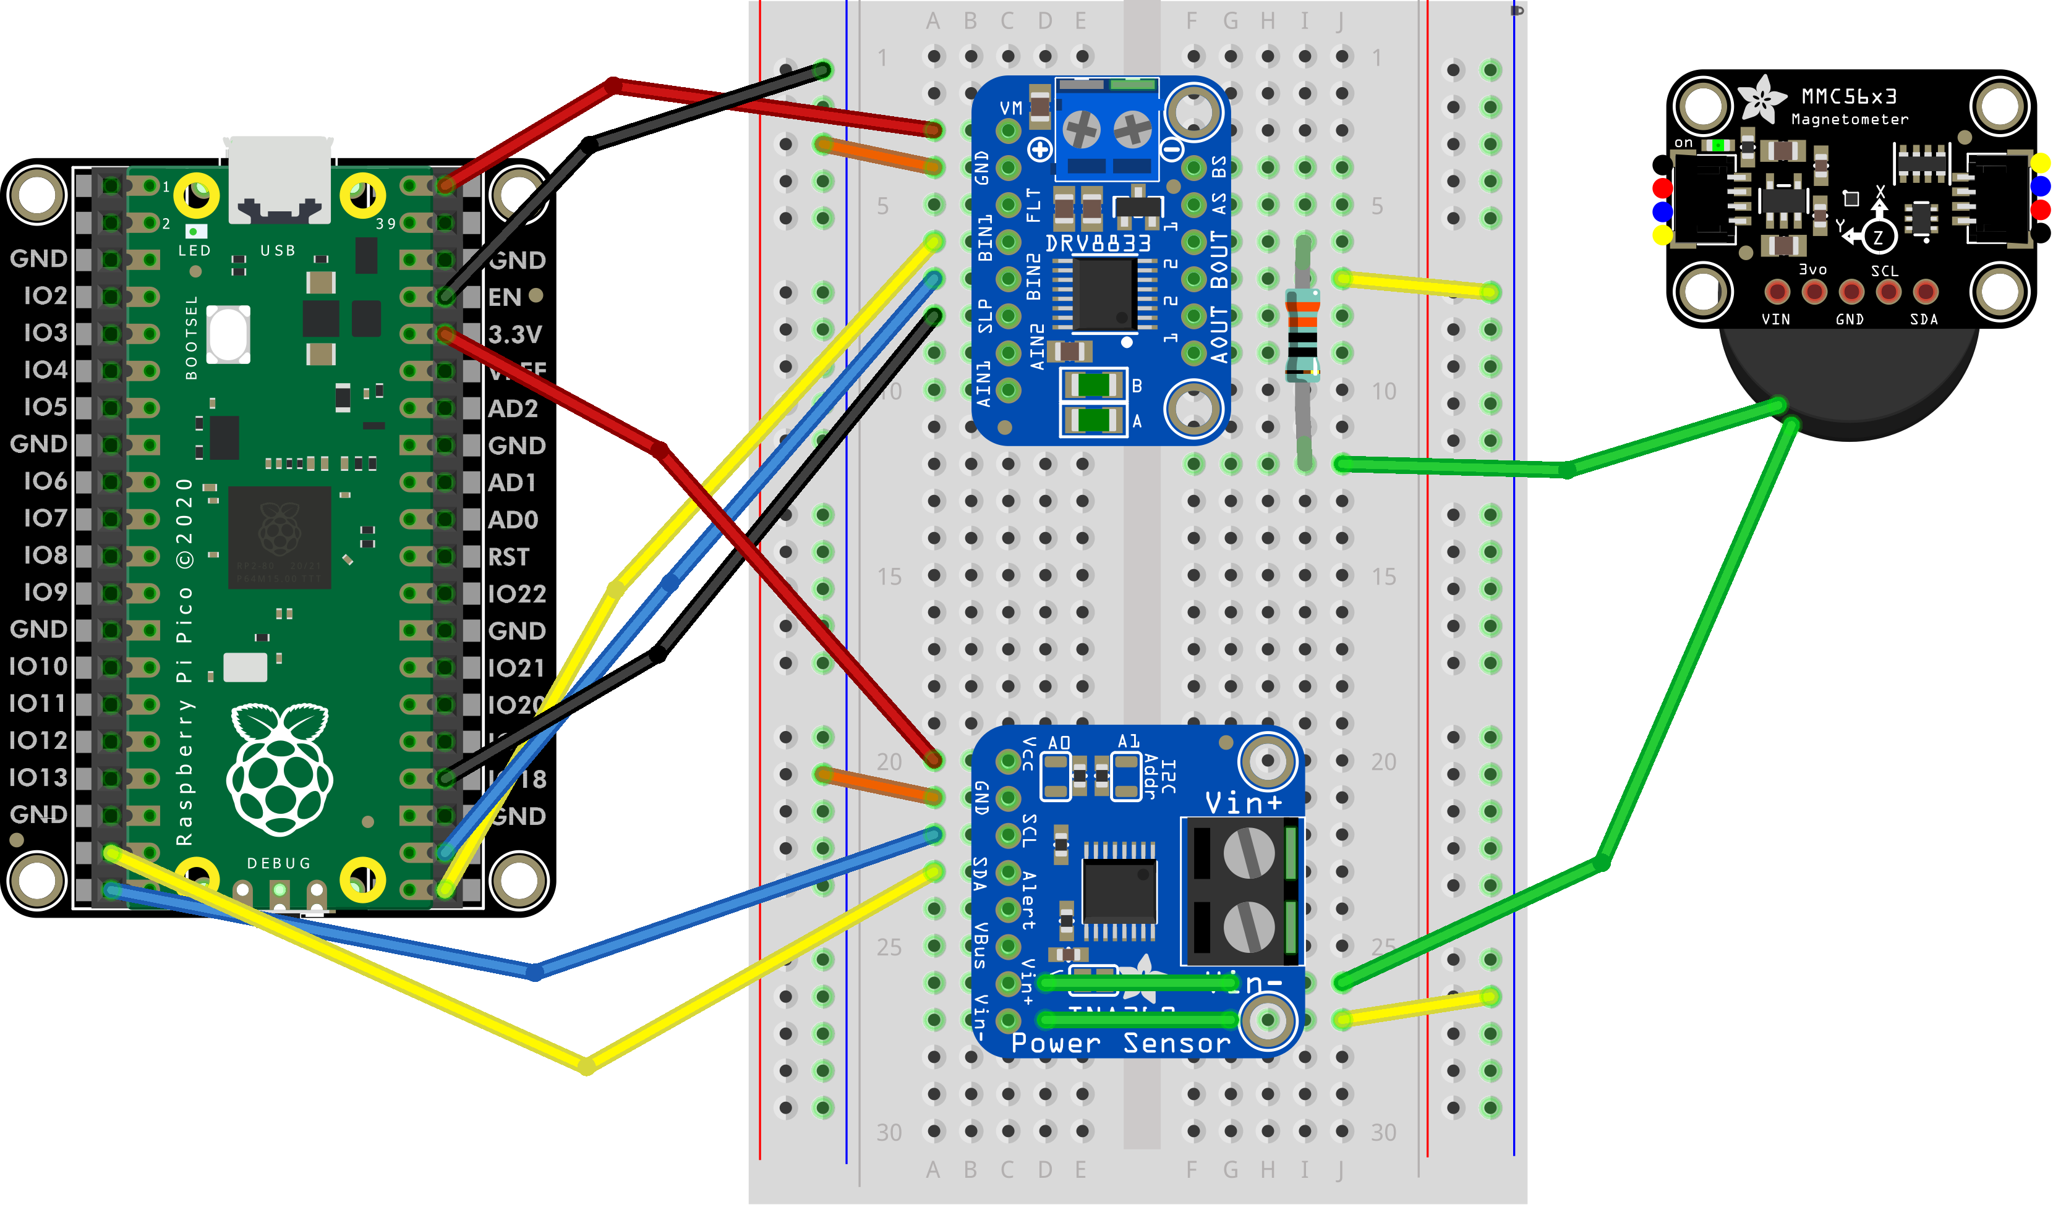
Why We Need a Motor Driver
+5V
The Pi Pico alone cannot provide enough power (only +3.3V @ 20mA)
to drive a 5V electromagnet
The DRV8833 Motor Driver can apportion that USB power in fine increments to the electromagnet
The Pi Pico provides a VBUS pin that taps directly into your laptop's
USB port power (+5V @ 500mA)
We will use an INA260 sensor to measure the actual current (mA) flowing through the electromagnet

Slide 15
Why We Need a Motor Driver
The Pi Pico can set the output voltage of the DRV8833 using PWM on pins GP17 and GP16
The Pi Pico can kill the power to the electromagnet by putting the DRV8333 to sleep via GP18

Slide 16
Why We Need a Motor Driver
This 330 Ω resistor prevents pulling too much current out of the DRV8833

Slide 17
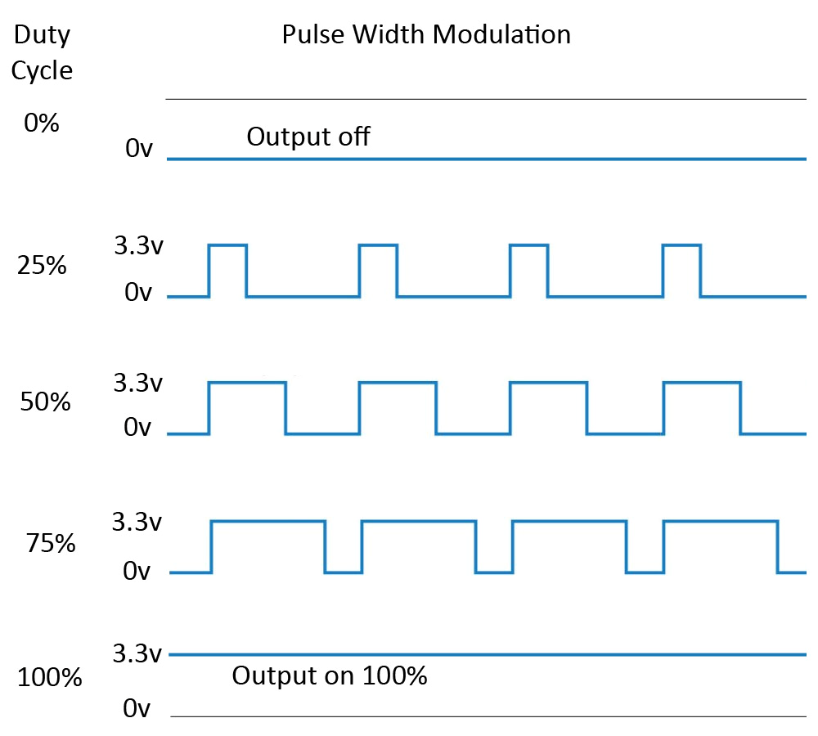
Digital to Analog Conversion via PWM
$$0V$$
$$3.3×0.25=0.825V$$
$$3.3×0.50=1.65V$$
$$3.3×0.75=2.48V$$
$$3.3V$$

Slide 18
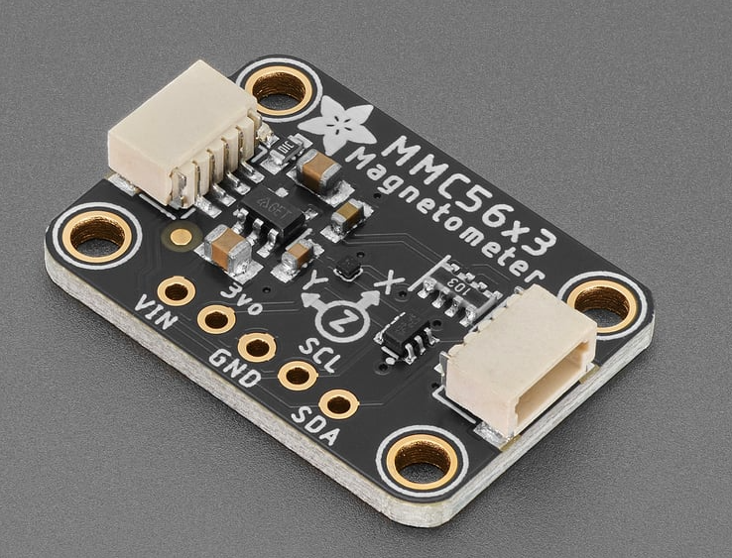

Adafruit Triple Axis Magnetometer
$5.95
https://www.adafruit.com/product/5579

Slide 19
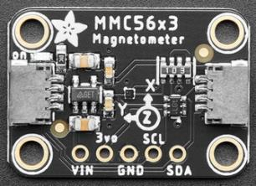
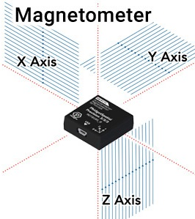
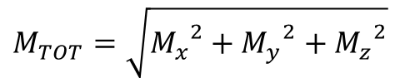
Triple Axis Magnetometer
Because the magnetic fields at the top of the electromagnet extend in all three dimensions, we will use this formula to find the total magnitude (strength) of the field:
$$M_{TOT}=\sqrt{{M_{x}}^{2}+{M_{y}}^{2}+{M_{z}}^{2}}$$

Slide 20
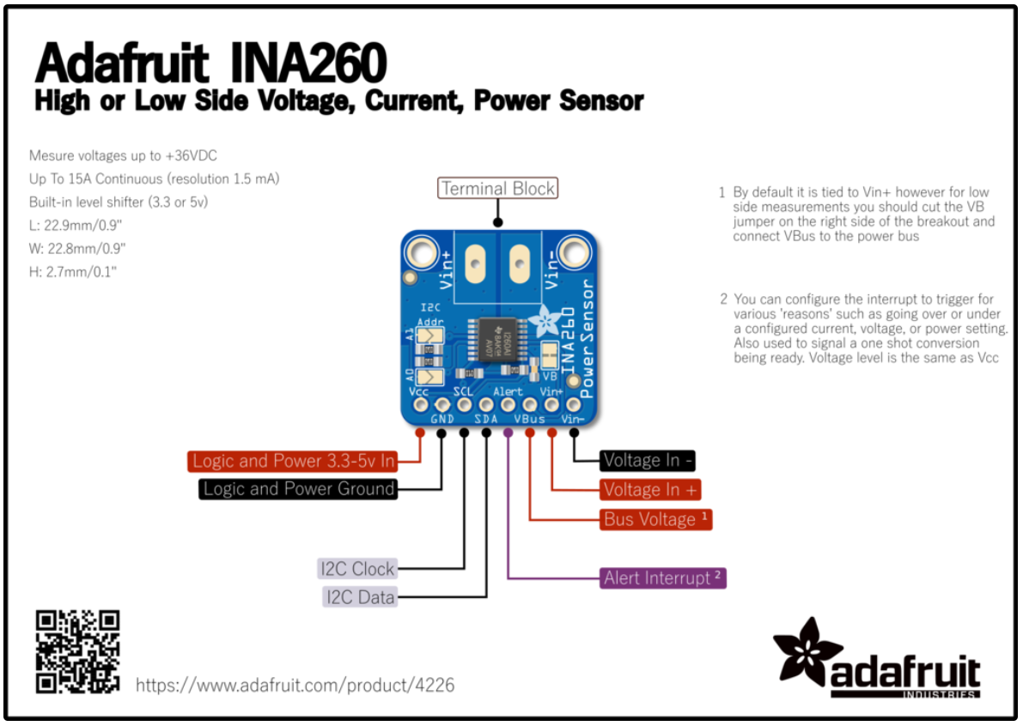
Adafruit INA260 Current Sensor
https://www.adafruit.com/product/4226
$9.95

Slide 21
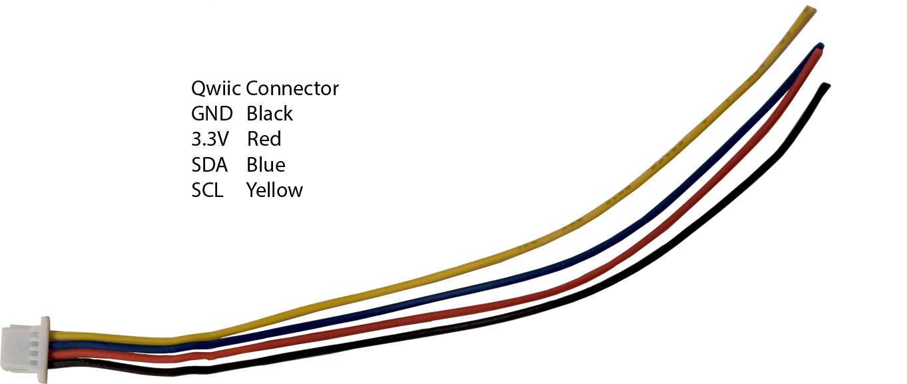
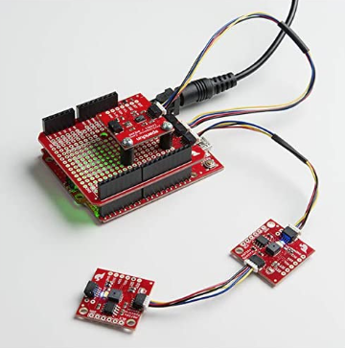
What is a Qwiic Connector?
Qwiic is an I2C cable developed by SparkFun
Adafruit calls their Qwiic compatible connector STEMMA-QT

Slide 22
Unplug the MCU before changing any wiring!
As we move between each “experiment” on a given breadboard or switch to an entirely new Board #, it is crucial that you FIRST UNPLUG the USB cord!
I recommend unplugging the cord at the PC end – leave the cord connected to the Micro USB port on the Pico
It is dangerous to change any wiring while the MCU is still drawing power from your laptop’s USB port
If you incorrectly connect a jumper wire between the Pico and the breadboard while the Pico is drawing power from your PC, you can permanently damage your PC’s USB port
Have your partner double-check your wiring every step!

Slide 23
Wire Your Pico to Board 07
i2c_bus0
i2c_bus1

Slide 24
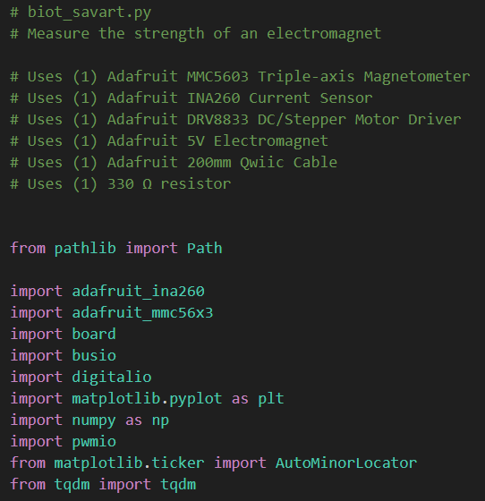
Open biot_savart.py
①
②
③

Slide 25
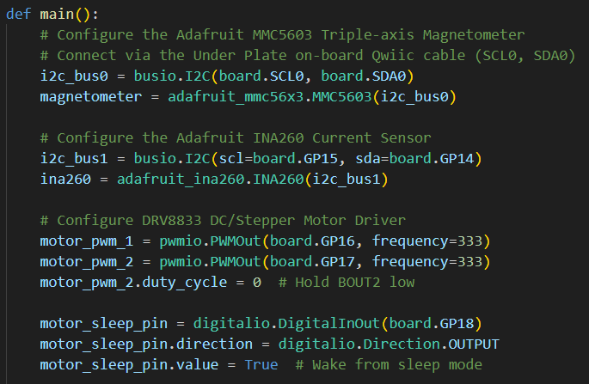
View biot_savart.py
①
②
③
④
⑤
⑥
⑦
⑧

Slide 26
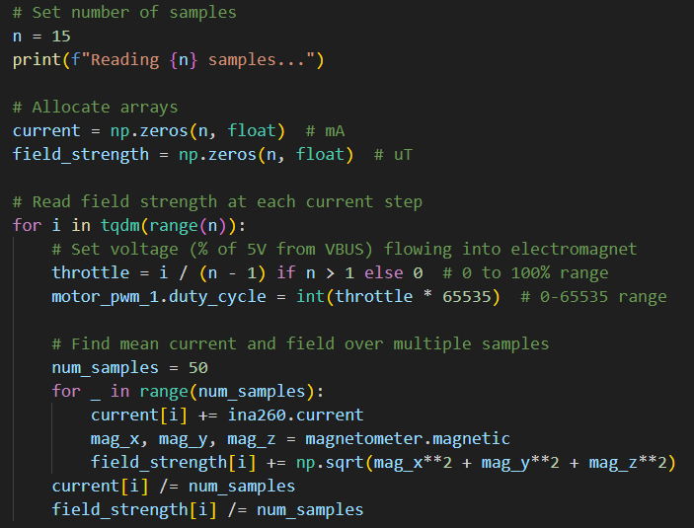
View biot_savart.py
①
②
③
④
⑤
⑥
⑦
⑧
⑨
⑩

Slide 27
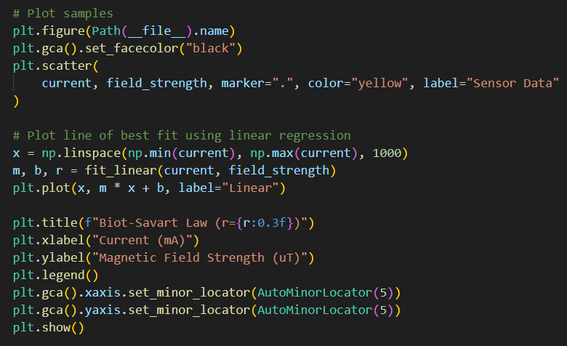
View biot_savart.py
①
②
③
④
⑤
⑥

Slide 28
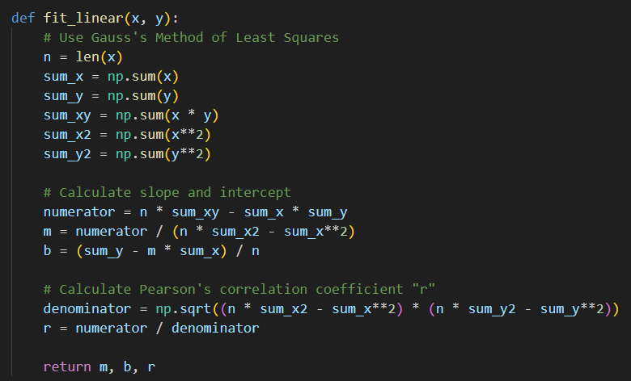
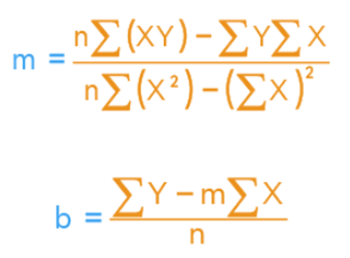
View biot_savart.py
①
②
③

Slide 29
Connect the Pico to Your PC
If you incorrectly connect a jumper wire between the Pico and the breadboard, you can permanently damage your PC’s USB port!
Have your partner double-check your wiring before you plug in the USB cable back into your PC

Slide 30
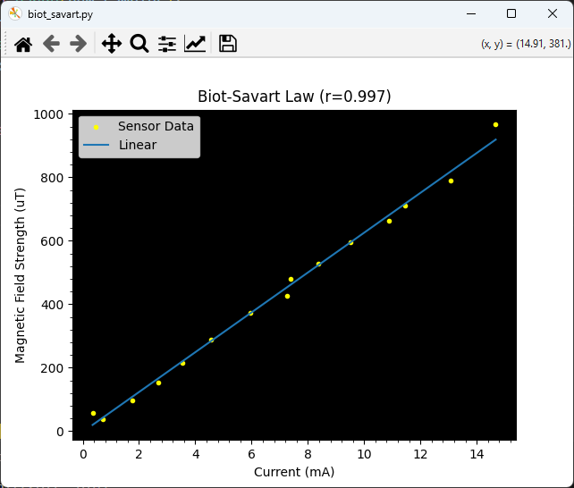

Run biot_savart.py
$$B=μ×n×I$$
constants

Slide 31
Board 07 – Now You Know…
The Biot-Savart Law contains the physics (vector calculus) to predict the magnetic field in regions of steady flowing current (use Maxwell's Equations for fluctuating currents)
For an electromagnet (a solenoid), the exact analytic solution to the Biot-Savart equation shows a linear relationship between the magnetic field strength and the current (not the voltage)
Small microcontrollers typically cannot drive high voltage or high current outputs
ICs like the DRV8833 motor driver allow the Pi Pico to control devices that require a much higher power draw to function properly

Slide 32
What We Didn't Cover…
Darlington and Field Effect Transistors (MOSFETs)
Transformers and Power Supplies
True AC Signals
Bridges / Rectifiers
Flyback Diodes
Decoupling Capacitors
Modulation (AM/FM/PM/PSK)
Signal Attenuation (dBm)
Digital Electronics
Laplace Transforms
Transfer Functions
Phase Locked Loops
Crystal Oscillators
PCB Layout and Design
Batteries
Environmental Effects
There is so much more you get to learn! ☺

